Slide 1
Google, Apple, and Microsoft Struggle for Your Internet Experience
Case Study

Slide 2
Prepared for
Dr. Mohammed Shafiul Alam Khan
Associate Professor
Institute of Information Technology
University of Dhaka
Prepared by
Tulshi Chandra Das (BSSE0811)
Afia Sajeeda (BSSE0832)
Saara Sheneen (BSSE0833)
Maloy Kanti Sarkar (BSSE0834)

Slide 3



THE THREE TECH GIANTS

Slide 4
Apple Inc.
Main focus: Mobile Devices
Closed proprietary standards

Slide 5
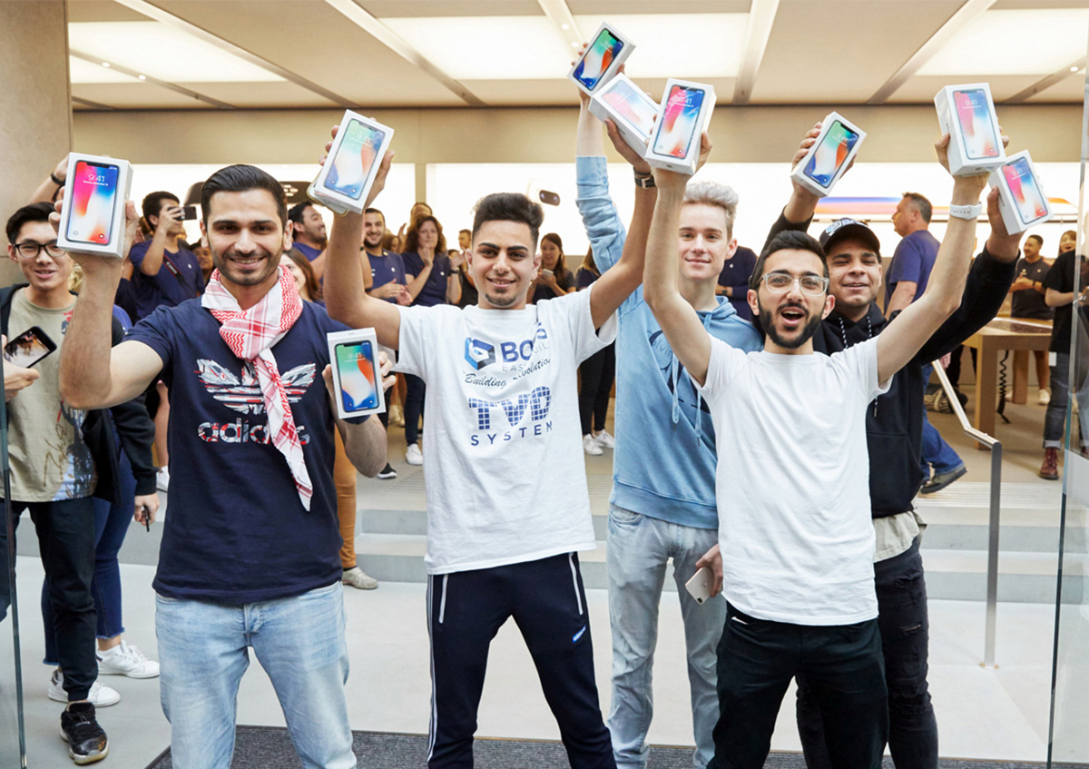
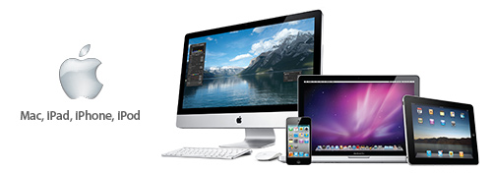
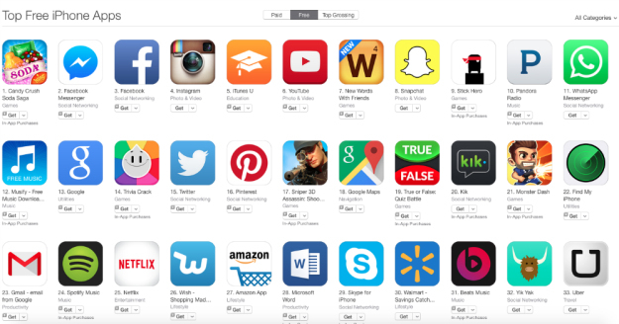
Apple- The King in Mobile Software Application
Vibrant Selection Choices From 250K+ Apps
iMac
iPod
iPhone
iPad
Loyal Fans

Slide 6
Apple Inc.
Achievements include:
iPhone & iPad sales account for 52% of the total profit
27% of the mobile market
iPhone is the highest grossing cellphone ever

Slide 7
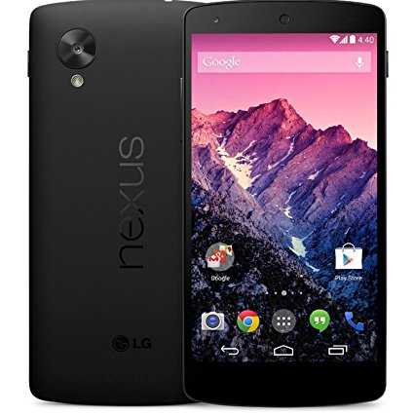

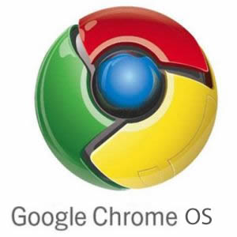
Google
Mobile
Advertisement
Operating System

Slide 8
Google
Dominates the advertising market with their search engine
Android OS covers 41% mobile market share

Slide 9
Microsoft
Main focus: Operating System
Achievements:
Still the leader in PC Operating Systems
and desktop productivity software
95% PCs still run on Microsoft Windows
Failures:
Smartphone hardware & software
Mobile computing
Cloud based software apps

Slide 10
Mobile Computing: The Point of Revolution
Research firm Gartner’s prediction:
By 2013, mobile will surpass PCs as the medium for Internet accession
Statistics:
Year | Percentage of use of mobile for Internet Accession
2007 | 5%
2013 | 23.5%
2015 | 56%

Slide 11


Mobile Computing: The Point of Revolution
Mobile Internet Devices came into existence because of the growth of cloud computing capacity. This lead to preference of
over

Slide 12
Mobile Computing: The Point of Revolution
Applications and app stores played a significant role in the success of mobile computing
They enhance user experience

Slide 13
Applications, App Stores and User Experience
versus
Non proprietorship versus Proprietorship software

Slide 14
THE THREE TECH GIANTS
Healthy competitors in Mobile market trying to limit Microsoft
Plain Enemies
Competitors in Mobile market

Slide 15
THE THREE TECH GIANTS
Aggressive competitors in Mobile market
Plain Enemies
Healthy Competitors in Mobile market targeting to take down Google

Slide 16
SURVIVAL OF THE FITTEST
Apple dominated Mobile Market. Microsoft failed. Google released Android.
Google and Apple’s clashes over Apple’s proprietary standards, Apple’s rejection of Google Voice services
Google CEO Eric Schmidt stepped down from his post on Apple’s board of directors
Google snatching away AdMob to stall Apple. Apple sued HTC citing patent infringement
Apple considering to make Microsoft’s Bing its default search engine on both iPhone and Apple’s Web Browser to take down Google

Slide 17
SURVIVAL OF THE FITTEST
Google tried to take on Apple after purchasing Android. Its objective was to counter Microsoft
Apple dominated Mobile Market. Microsoft failed. Google released Android.
Google and Apple’s clashes over Apple’s proprietary standards, Apple’s rejection of Google Voice services
Google CEO Eric Schmidt stepped down from his post on Apple’s board of directors
Google snatching away AdMob to stall Apple. Apple sued HTC citing patent infringement
Apple considering to make Microsoft’s Bing its default search engine on both iPhone and Apple’s Web Browser to take down Google

Slide 18
SURVIVAL OF THE FITTEST
Google did not want Apple to block its services on iPhone and other smartphones.
Apple dominated Mobile Market. Microsoft failed. Google released Android.
Google and Apple’s clashes over Apple’s proprietary standards, Apple’s rejection of Google Voice services
Google CEO Eric Schmidt stepped down from his post on Apple’s board of directors
Google snatching away AdMob to stall Apple. Apple sued HTC citing patent infringement
Apple considering to make Microsoft’s Bing its default search engine on both iPhone and Apple’s Web Browser to take down Google
Apple cited privacy concerns as the reasons.

Slide 19
SURVIVAL OF THE FITTEST
Apple dominated Mobile Market. Microsoft failed. Google released Android.
Google and Apple’s clashes over Apple’s proprietary standards, Apple’s rejection of Google Voice services
Google CEO Eric Schmidt stepped down from his post on Apple’s board of directors
Google snatching away AdMob to stall Apple. Apple sued HTC citing patent infringement
Apple considering to make Microsoft’s Bing its default search engine on both iPhone and Apple’s Web Browser to take down Google
Two companies went all out on war

Slide 20
SURVIVAL OF THE FITTEST
Apple dominated Mobile Market. Microsoft failed. Google released Android.
Google and Apple’s clashes over Apple’s proprietary standards, Apple’s rejection of Google Voice services
Google CEO Eric Schmidt stepped down from his post on Apple’s board of directors
Google snatching away AdMob to stall Apple. Apple sued HTC citing patent infringement
Apple considering to make Microsoft’s Bing its default search engine on both iPhone and Apple’s Web Browser to take down Google
Google did not expect to earn close to anything from AdMob which sells banner ads for mobile apps

Slide 21
SURVIVAL OF THE FITTEST
Apple dominated Mobile Market. Microsoft failed. Google released Android.
Google and Apple’s clashes over Apple’s proprietary standards, Apple’s rejection of Google Voice services
Google CEO Eric Schmidt stepped down from his post on Apple’s board of directors
Google snatching away AdMob to stall Apple. Apple sued HTC citing patent infringement
Apple considering to make Microsoft’s Bing its default search engine on both iPhone and Apple’s Web Browser to take down Google
A scheme to strengthen Microsoft to take down Google

Slide 22
Too early to say
WHO WILL SURVIVE?
Apple
App sales and user experience
Dependent on sale of devices
Google
Advertising and Android which is an iPhone competitor
Dependent on Advertising
Microsoft
PC and Operating Systems
Dependent on software services

Slide 23
But Google is continuously on the move
WHO WILL SURVIVE?
Apple
Microsoft
Potential to take over Google

Slide 24
But Apple has been unbeatable when it comes to user experience
WHO WILL SURVIVE?
Google has-
Android to combat Apple
Chromebook and Chrome OS to combat Microsoft
Both products have been gaining popularity
PCs and Operating systems are Microsoft’s strength

Slide 25
A scenario: Just one of the tech giants dominated the Internet experience
Creation of Vendor Dependency in the Market
Switching Costs would increase
Setting up a standard in the market
No competition might lead to less innovations

Slide 26
THANK YOU!
Any questions?

Slide 27
SOURCES OF IMAGES
https://diylogodesigns.com/wp-content/uploads/2016/04/Microsoft-Logo-icon-png-Transparent-Background-768x768.png
http://www.stickpng.com/assets/images/580b57fcd9996e24bc43c51f.png
https://pcspezialist-kassel.de/wp-content/uploads/2015/09/apple-logo.gif
https://boygeniusreport.files.wordpress.com/2017/11/iphone-x-launch-day.jpg?quality=98&strip=all
https://itcdatarecovery.com/wp-content/uploads/2014/12/AppleDataRecovery.jpg
https://s.aolcdn.com/hss/storage/midas/2797fea6a0757898e196b6ec0bb94d4f/206605410/AppStore.jpeg
https://upload.wikimedia.org/wikipedia/commons/thumb/c/c7/Google_Ads_logo.svg/1200px-Google_Ads_logo.svg.png
https://product.hstatic.net/1000238589/product/lg_nexus_5_d820_large.jpg
https://justitarchive.files.wordpress.com/2010/12/google-chrome-os-logo.jpg
http://www.northstartechnologygroup.com/wp-content/uploads/2015/10/Mobile-devices.jpg
https://i5.walmartimages.com/asr/98a9edf3-8c17-4265-8f7d-e821d9290e43_1.eb7d853d5f4e5b579a2e3130d78ff56e.jpeg

